Slide 1
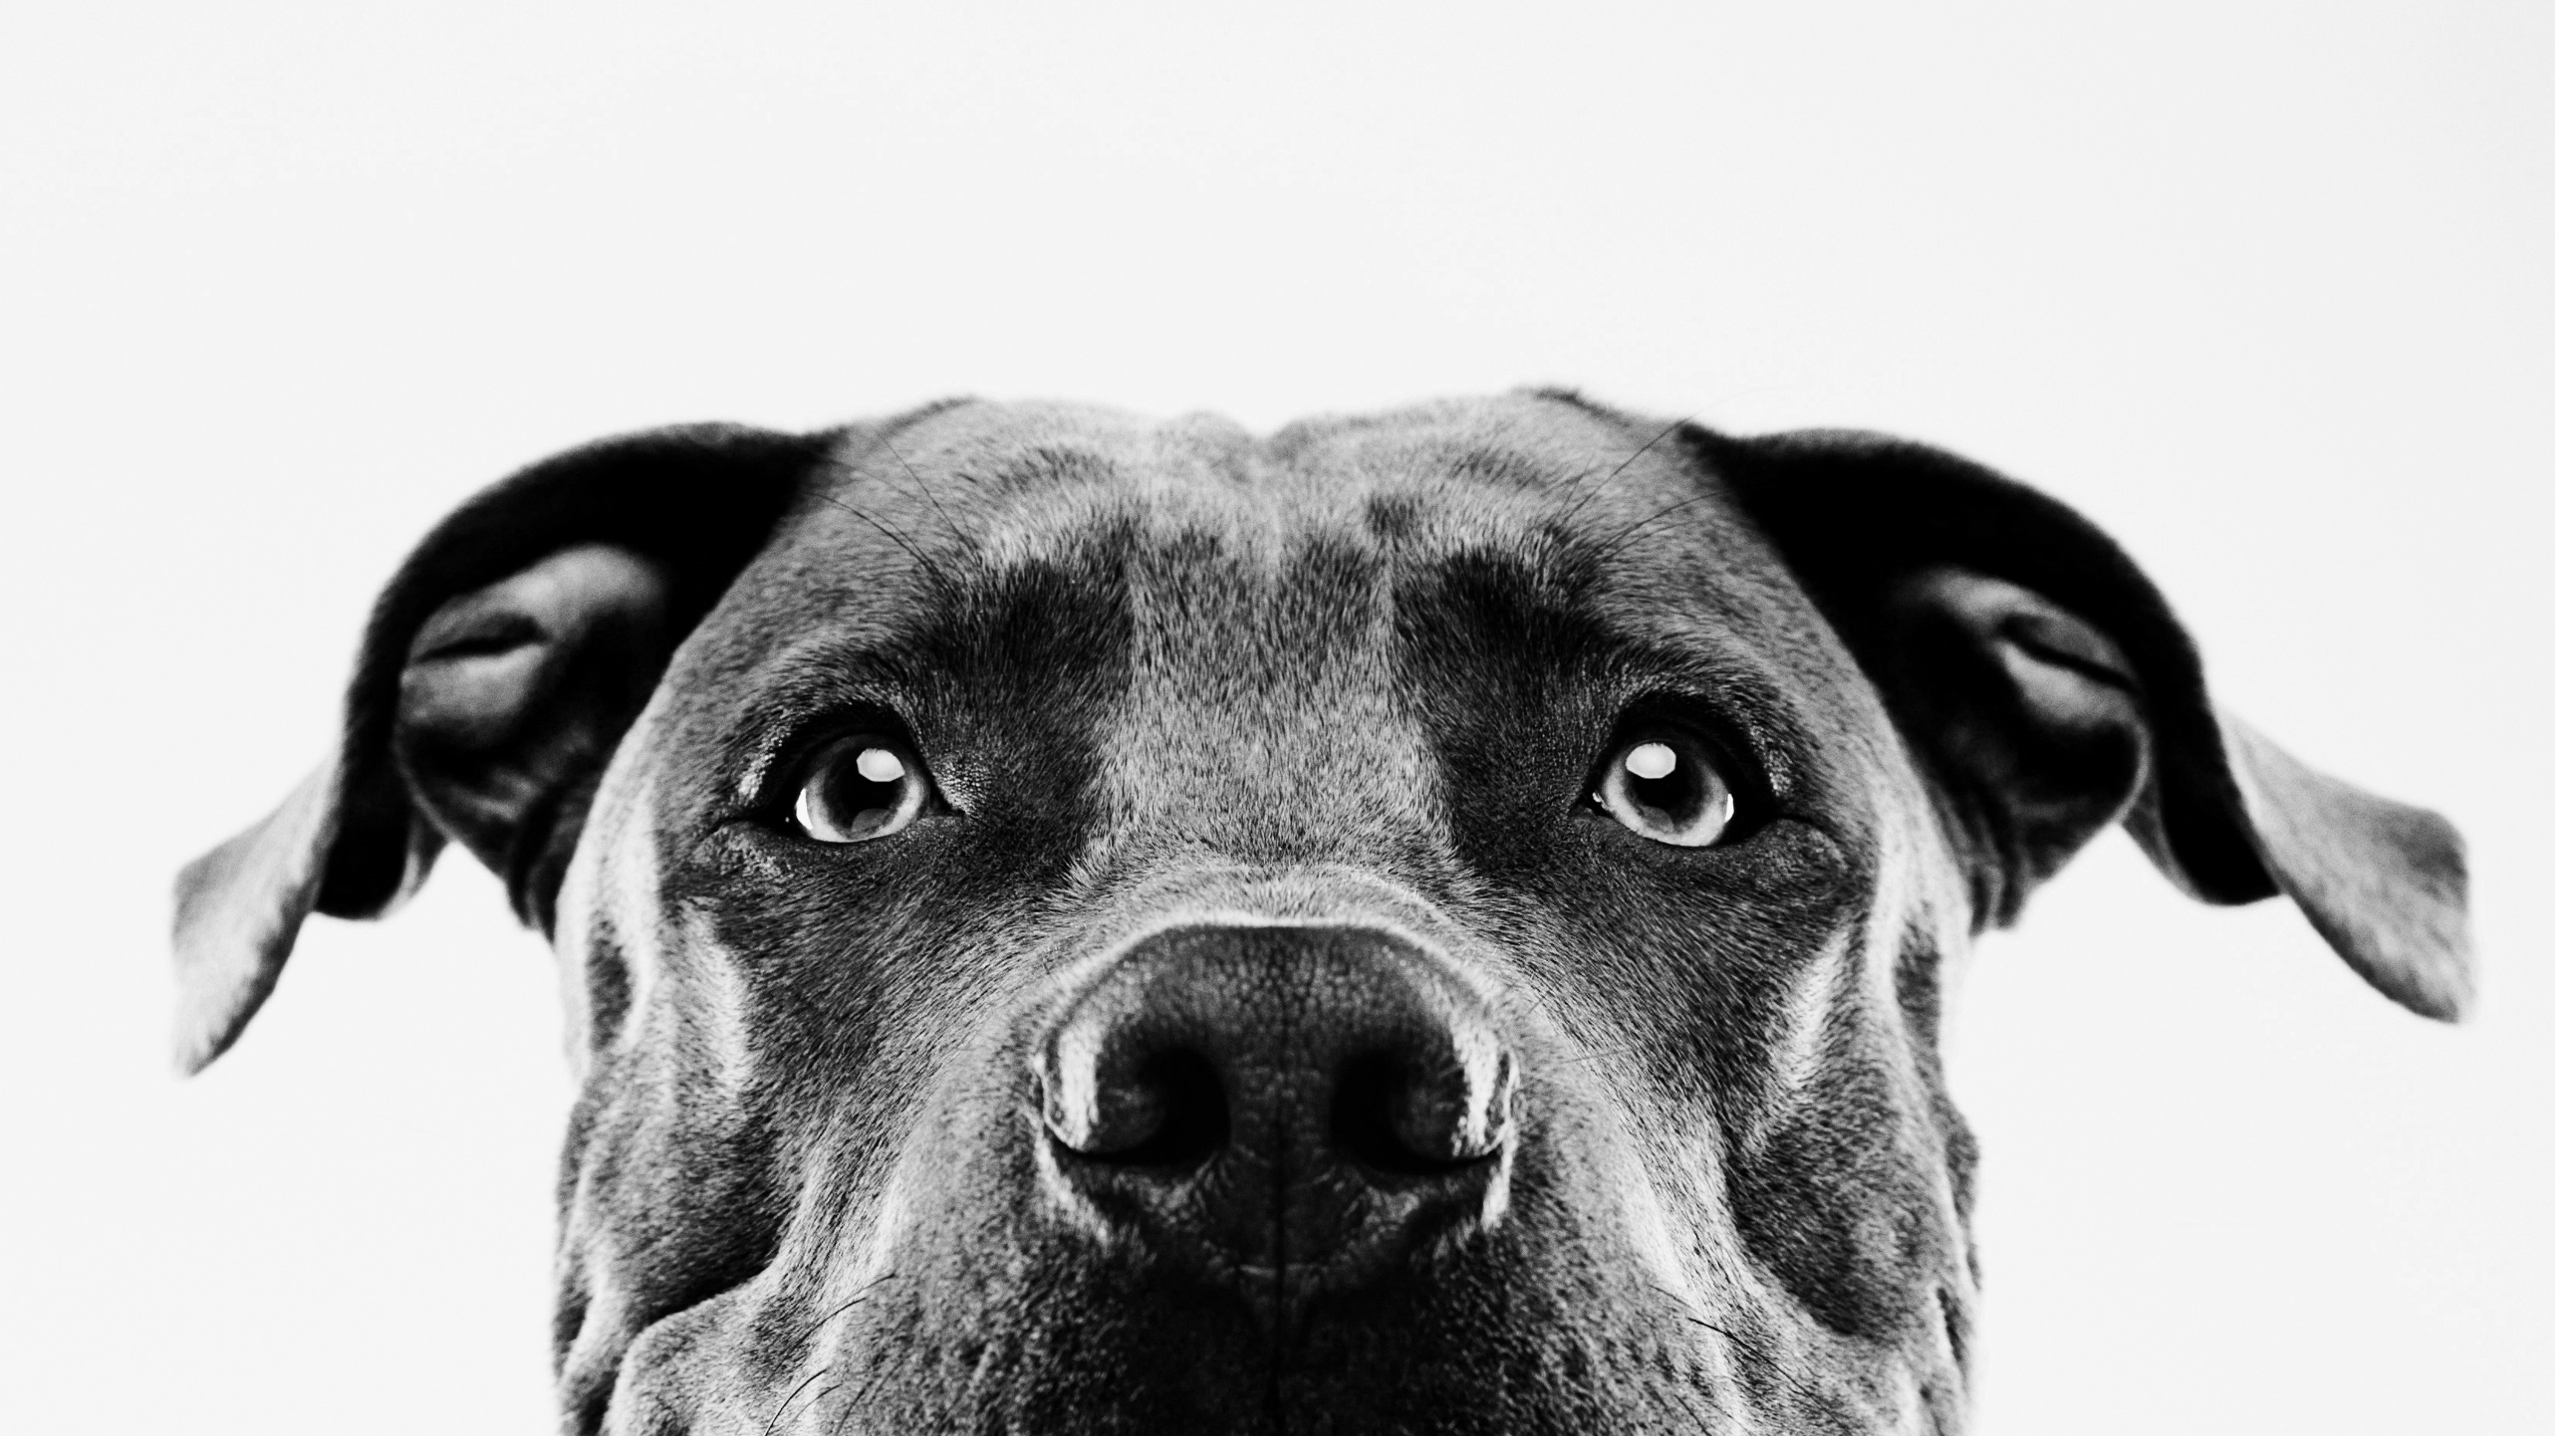
NLP Project Trying to understand the meaning behind barks
Team Members:
Purushottam Hari (17bce2182)
S.Mahika Rao (17BCE0944)

Slide 2
Problem statement
Our project idea was to firstly gather a dataset consisting of the barks of a particular dog over a substantial period of time.
Then isolate the barks and the respective timestamps on the video.
Then train a model using Deep Learning to understand patterns within the barks.
Cross Verify the results using the timestamps on the video

Slide 3
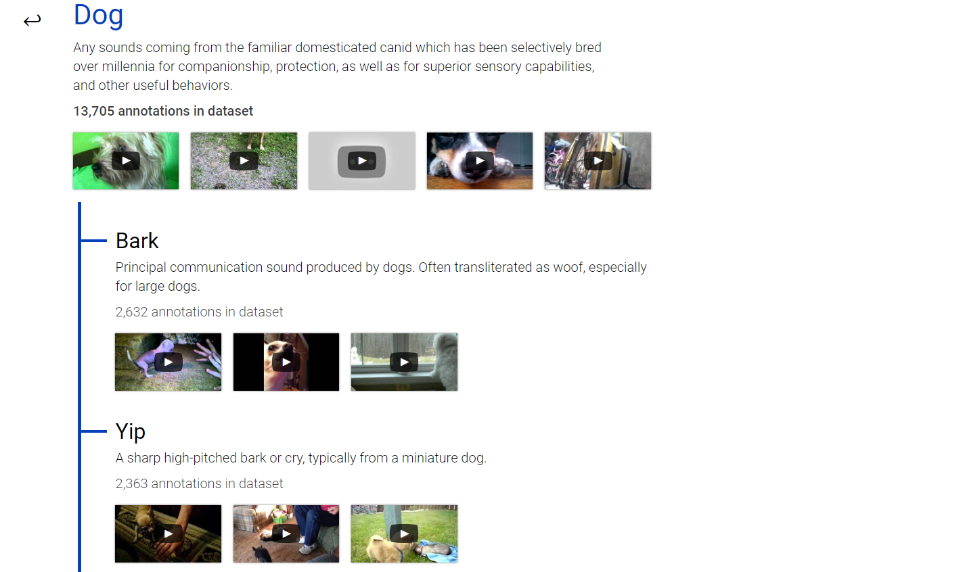
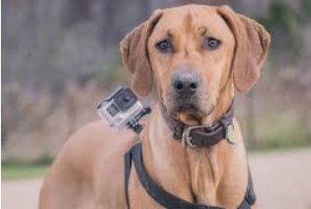
Dataset collection
Unfortunately after looking at many options in our campus, we couldn’t collect the required dataset in the format we needed for this project since it required the use of an expensive camera like a GoPro which needed to be attached to a harness like so.
We tried to hence record bird noises in shops right outside our campus, but their sounds were too feeble to be captured clearly on a Mobile’s microphone.
But gladly after researching on this topic we came across a dataset which consisted of many Youtube Videos of various dogs barking https://research.google.com/audioset/ontology/dog_1.html ......
so we continued our project with this source so that we could at least understand how the model can be built and
the various steps that need to be looked out for if we get a Quality Dataset in the future.

Slide 4
Step By Step Procedure
We first downloaded around 200 videos each using the dataset we found onto our systems.
Then using a video editor, we sliced the videos to the exact moments where the barks were heard.
We named the sliced videos with the breed and the assumed emotion of the dog in the video for reference.
Then using VLC Media Player, we were able to convert these sliced video files into .wav files so that we could train them.
Now to train the sounds, we found these effective ways of doing them-
Derive the wave form images from the wav files.
Use spectrograms of the wav files.
We went ahead with the first method and divided the images generated properly into training and testing sets.
Thereafter we used a Deep CNN Model to train on this data to see if patterns are recognized.
Here are some screenshots of the procedure mentioned above

Slide 5
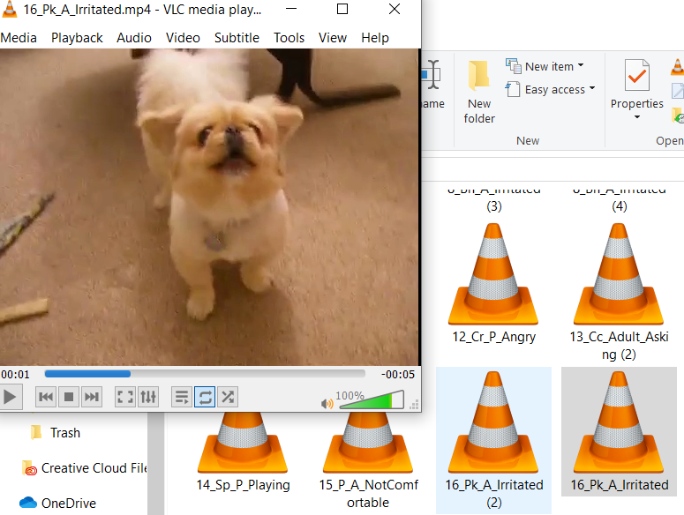
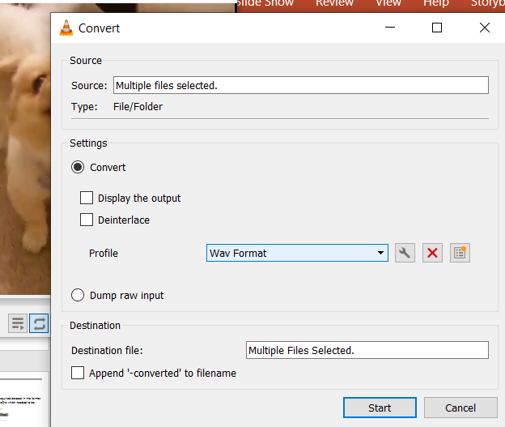
Screenshots
Trimming videos with tagging them.
Converting them into wav format using VLC

Slide 6
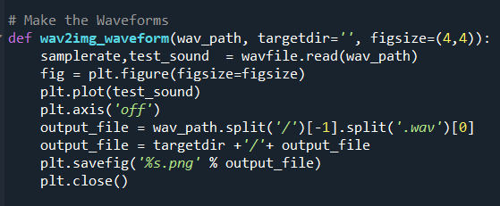
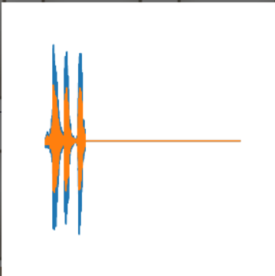
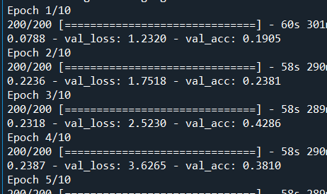
Screenshots
Python Script to generate Wave Forms
A Sample Waveform
CNN Training!

Slide 7
Challenges Faced
As mentioned before, collection of a quality dataset was the biggest issue we faced in this project
Pre-Processing and Manually sorting the dataset was a very cumbersome task
Some methods like MFCC and spectrograms demand that the wav file be of 1 second or less…which failed in our case since the video editor I used attached a “Brand” snippet of 2 seconds after each video.
But gladly, waveform representation can still be executed so we chose that format.
References
https://www.kaggle.com/davids1992/speech-representation-and-data-exploration
https://research.google.com/audioset/ontology/dog_1.html

